Slide 1
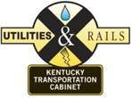
Managing Projects with Rail Involvement
September 7,2016
Allen Rust, PE
Rail Coordinator
KYTC
Troy Creasy
Project Manager – Public Projects
CSX Transportation, Inc.

Slide 2
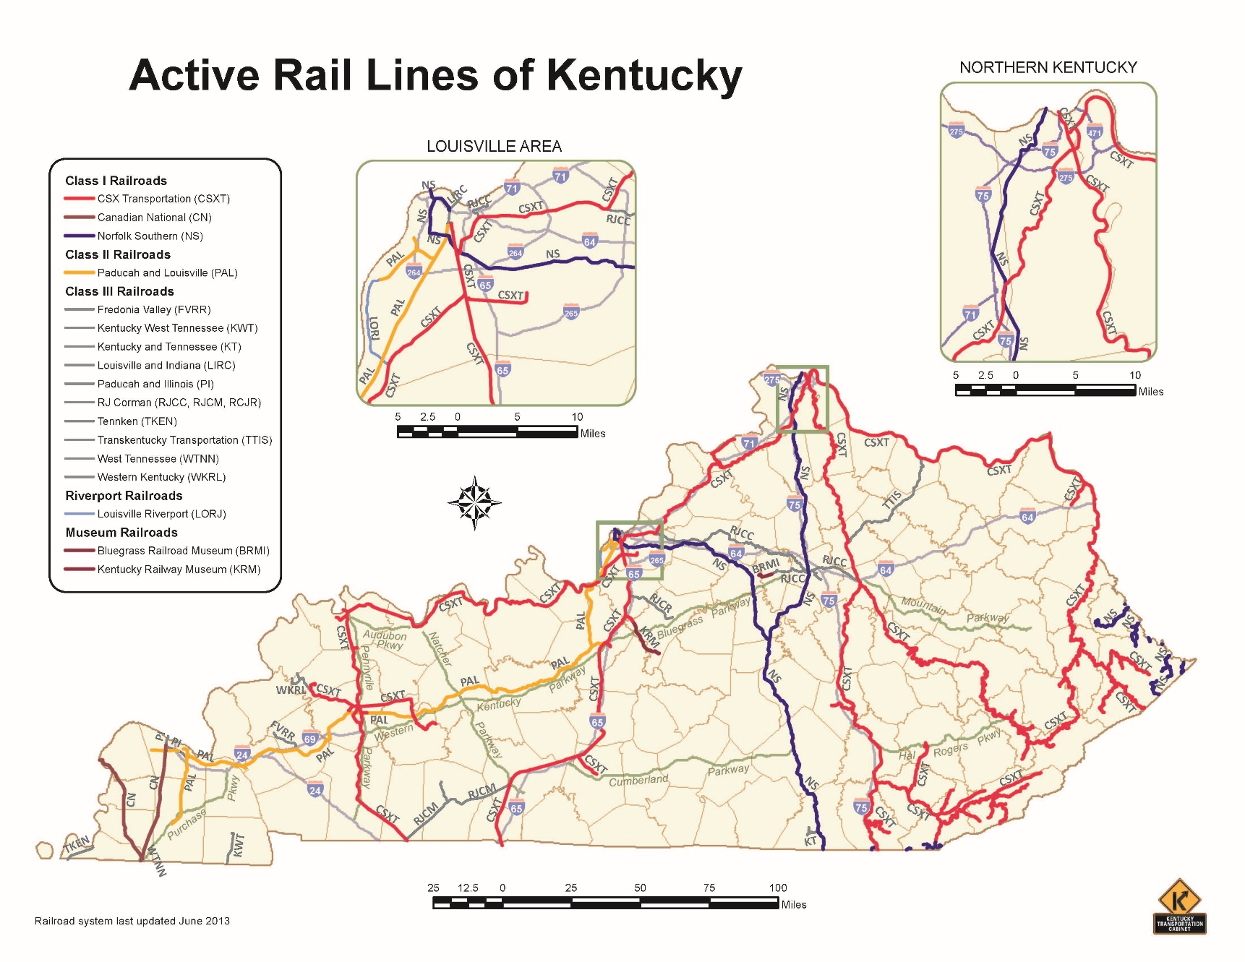
Railroads in Kentucky

Slide 3
Railroads in Kentucky
Railroad | Miles of Track in KY
CSX | 1,685
Norfolk Southern | 429
Paducah and Louisville | 280
RJ Corman | 197
Illinois Central | 98
TTI | 50
Others | 452
Total: 3,191 miles

Slide 4
CSX Overview
Founded in 1827, the CSX Transportation network encompasses about 21,000 route miles of track in 23 states, the District of Columbia and the Canadian provinces of Ontario and Quebec.
Nearly two-thirds of Americans live within CSX’s service territory.

Slide 5
CSX in Kentucky

Slide 6
Railroad Requirements
How to design for it
What to include
Railroad Coordination
Plan reviews
Agreements
ROW
Questions

Slide 7
Railroad Requirements
CSXT requires that new overhead bridges span CSXT’s right-of-way and have a minimum 23’ vertical clearance above top of rail.
Standard horizontal clearance from centerline of the track to the face of the pier or abutment shall typically be 25’-0” or greater
CSXT property and operations shall not be negatively impacted by the project.
Additional requirements found in CSX Public Projects Manual.

Slide 8
Railroad Coordination
Acquire Right of Way
Coordinate plan review with RR companies
Coordinate flagging to protect RR facilities
Ensure that Cabinet contractors perform to standards

Slide 9
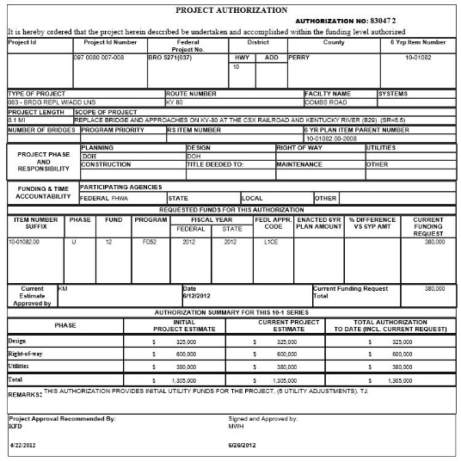
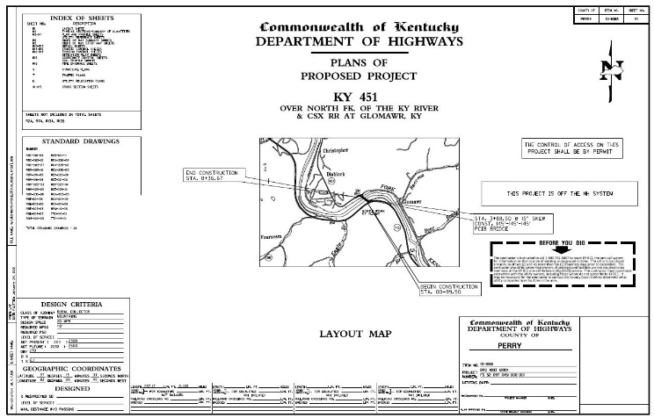
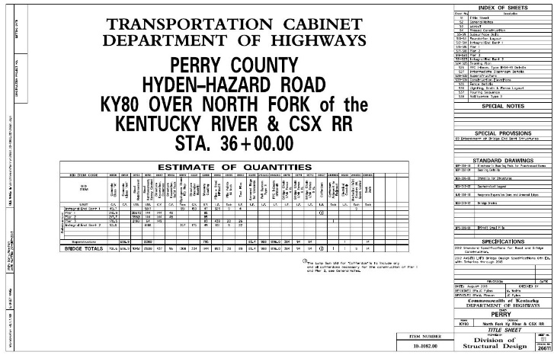
Initial Submittal
Funding
Primarily U
Can use D or C
Preliminary Road Plans
Preliminary Structure Plans

Slide 10
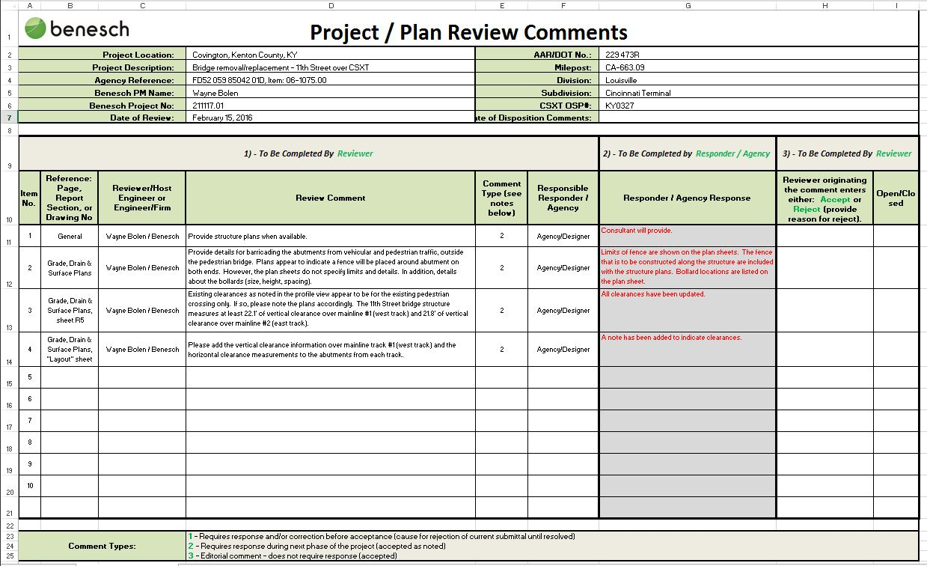
Comments Exchange
Railroad returns comments
Comment Spreadsheet
Designers address comments
Send revised plans to RR

Slide 11
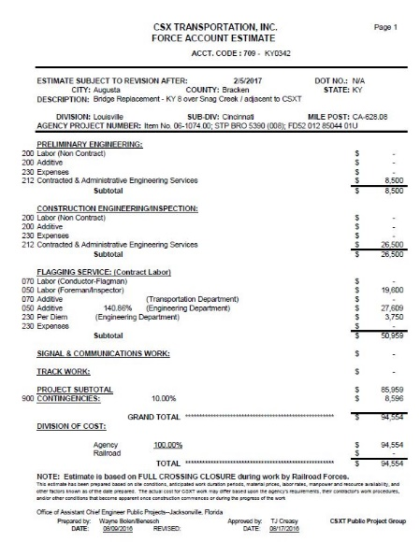
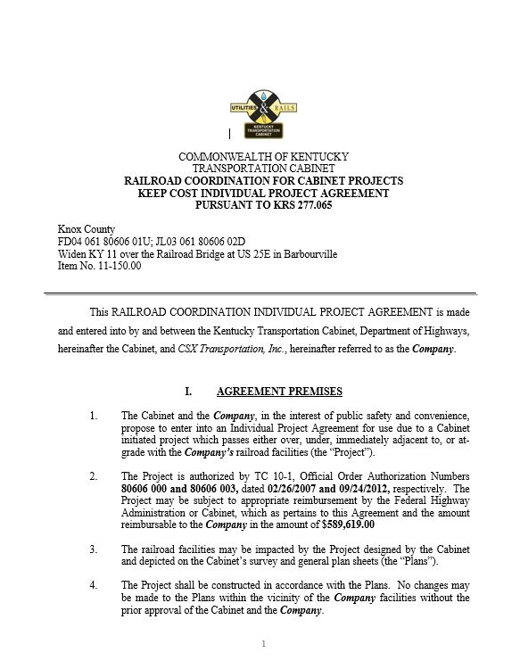
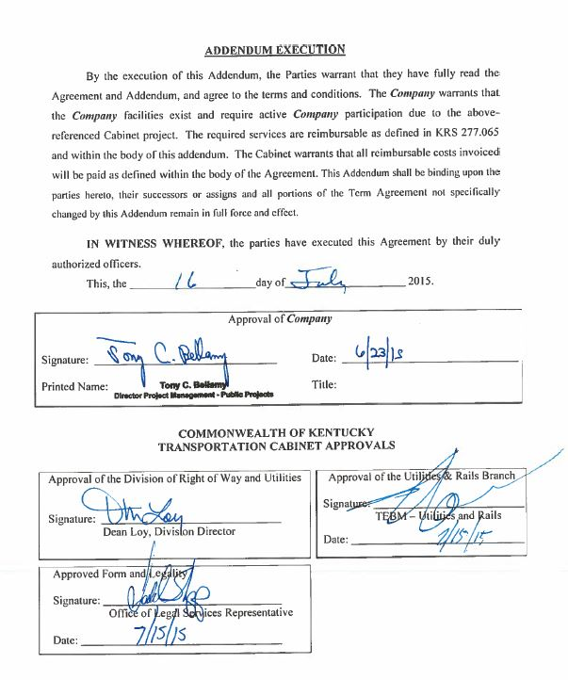
Agreement
Force Account Estimate (FAE)
Draft Agreement
Execution

Slide 12
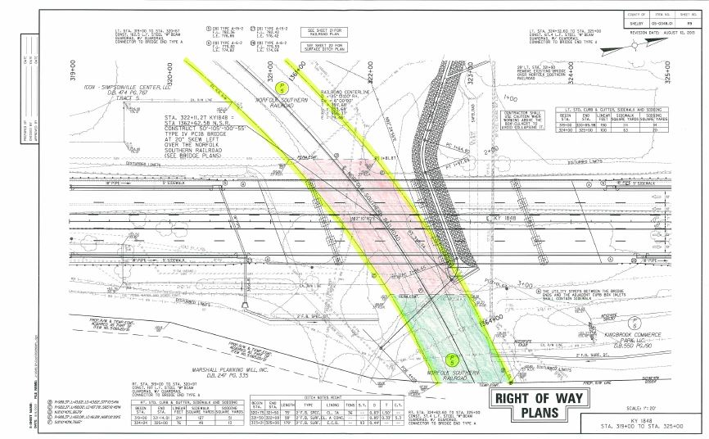
Right of Way
Offer
Offer to Purchase
MAR/Valuation
MOU
Plan Sheets
Deed Description
Payment
Recording

Slide 13
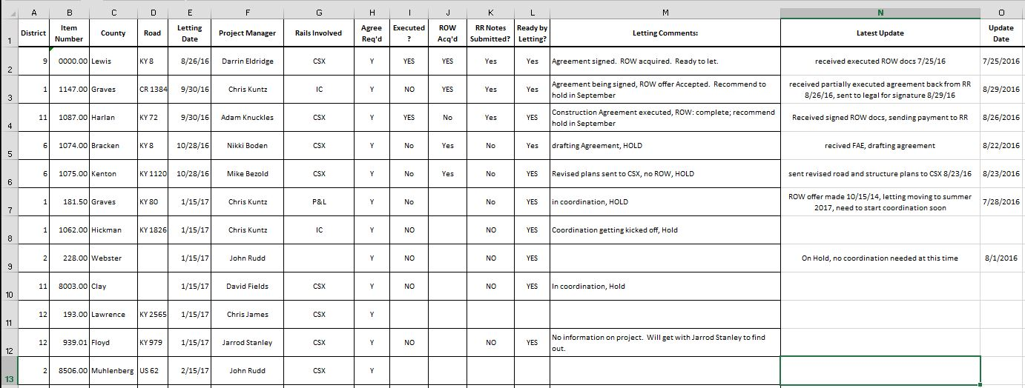
Changes
Preliminary Engineering Agreements
Flagging Note
Railroad Coordination Update

Slide 14
Questions?
Allen Rust, PE
Rail Coordinator
KYTC
Allen.Rust@KY.gov
502-782-4950
Troy Creasy
Project Manager – Public Projects
CSX Transportation, Inc.
Troy_Creasy@CSX.com
804-226-7718

